Slide 1
Neuro-Symbolic Classifier for Depression Analysis
Team Members:
Ashwin Umadi
Prajakta Kini

Slide 2
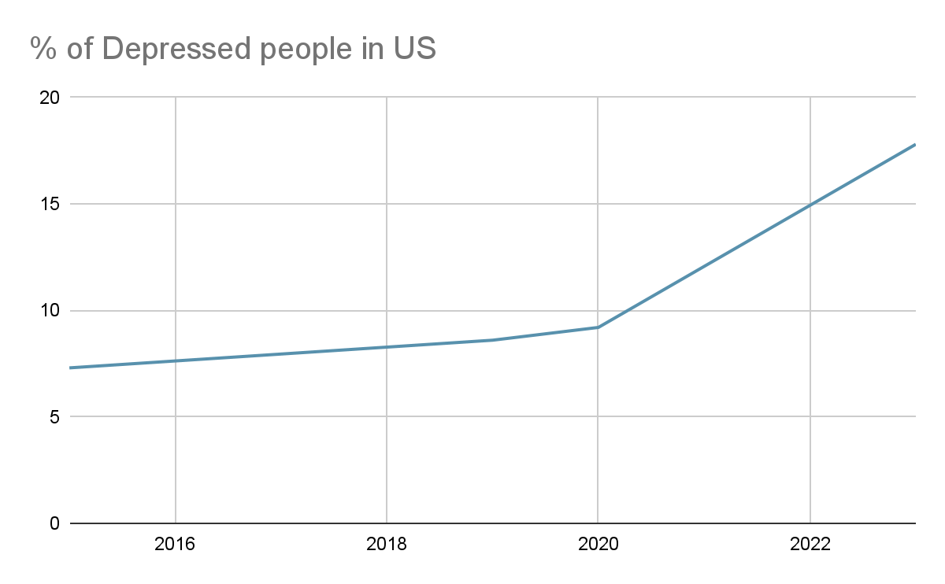
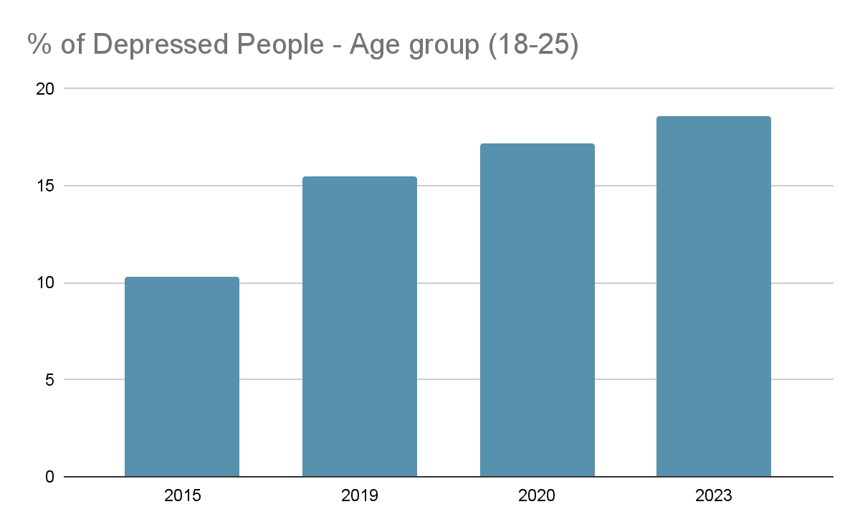
Problem Overview
Traditional machine learning models for depression classification lack interpretability
We propose a neuro symbolic model that combines the strengths of deep learning models with the transparency of rule-based systems
Benefits:
Improved accuracy
Enhanced interpretability
https://pmc.ncbi.nlm.nih.gov/articles/PMC9483000/

Slide 3
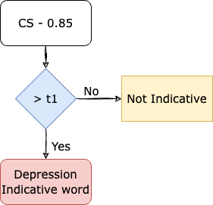
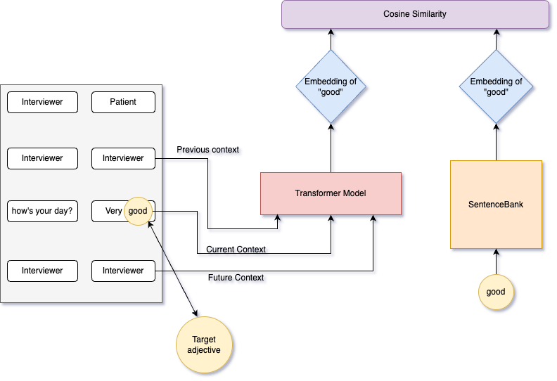
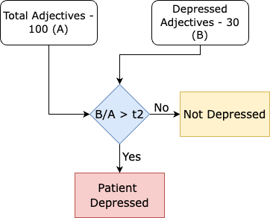
Rule Based Model
Rule 1: Depression-Indicative Words
Rule 2: Classifying the Interview

Slide 4
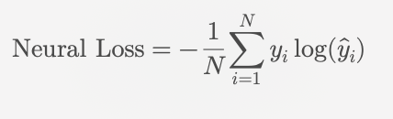
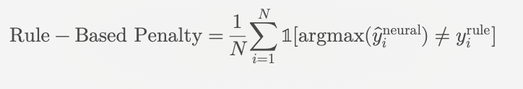
Neuro-Symbolic Classifier
Neural Component (MentalRoBERTa)
Symbolic Component (ADJ Rule-Based System)
Neural Loss : Cross Entropy Loss
Rule-Based Penalty
Neuro-Symbolic Loss
Where λ is a weighing factor that controls the influence of the rule-based penalty. Higher λ forces greater agreement with the rules.
Notes:
Neural Model
For RoBERTa and Mental RoBERTa, create QA Pairs. we split the question-answer pairs into chunks, each containing up to 300 words. We allowed up to 80- word overlap between chunks to ensure smooth transitions. To account for RoBERTa’s subword tokenization using Byte-Pair Encoding, we left some extra space for these tokens. Throughout this process, we carefully structured each chunk so that no question-answer pair was split across chunks, keeping each pair intact. We then fine-tuned these pre-trained models on our dataset specifically for depression classification.
\text{Neural Loss} = - \frac{1}{N} \sum_{i=1}^N y_i \log(\hat{y}_i)
Where:
• N: Number of samples in the batch.
• y_i: True label for the i-th sample.
• \hat{y}_i: Predicted probability of the true label for the i-th sample.
\text{Rule-Based Penalty} = \frac{1}{N} \sum_{i=1}^N \mathbb{1}[\text{argmax}(\hat{y}_i^{\text{neural}}) \neq y_i^{\text{rule}}]
Where:
• \mathbb{1}[\cdot]: Indicator function that equals 1 if the condition is true, otherwise 0.
• \text{argmax}(\hat{y}_i^{\text{neural}}): The predicted label from the neural model.
• y_i^{\text{rule}}: The predicted label from the rule-based model.
To align the neural model with the rules, a penalty term is added to the loss function.
This penalty is calculated based on the disagreement between the predictions of the neural model and the rule-based system.
Neural Predictions (logits):
logits = torch.tensor([
[2.5, 0.5], # Predicted class: 0
[0.2, 1.8], # Predicted class: 1
[1.0, 0.3],
[0.4, 2.1], ])
neural_predictions = torch.argmax(logits, dim=1)
print(neural_predictions) # Output: tensor([0, 1, 0, 1])
Labels
labels = torch.tensor([0, 1, 1, 0])
Rule-Based Predictions:
rule_predictions = torch.tensor([0, 1, 0, 0])
mismatches = (neural_predictions != rule_predictions)
print(mismatches) # Output: tensor([False, False, True, True])
mismatches_float = mismatches.float()
print(mismatches_float) # Output: tensor([0., 0., 1., 1.])
rule_penalty = torch.mean(mismatches_float)
print(rule_penalty) # Output: 0.5
Interpretation: 50% of the neural model’s predictions disagree with the rule-based predictions.
Neural loss (cross entropy loss) is 0.7352
lambda_weight = 0.1
total_loss = neural_loss + lambda_weight * rule_penalty
print(total_loss) # Example Output: 0.7352 + 0.1 * 0.5 = 0.7852

Slide 5
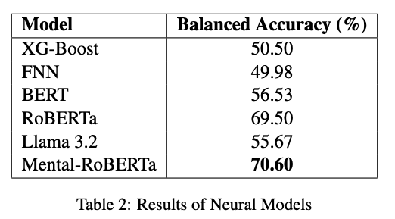
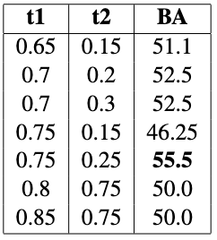
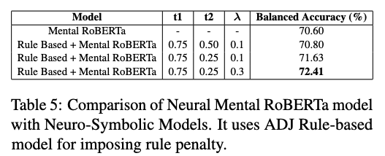
Experimental Results
Exp1: Neural Models
Exp2: Rule-Based Models
Exp3: Neuro-Symbolic Models

Slide 6
Thank You!

